Slide 1
American Indians
By: Susanna Martin
Click Me!

Slide 2
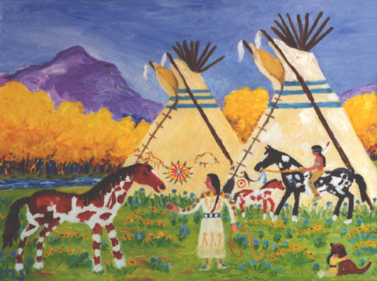
A long time ago, many different tribes of Indians lived and still live, in the land that we live in today! Today we are going to learn about 4 of these different tribes and take a short quiz over what we have learned.
Click Here!

Slide 3
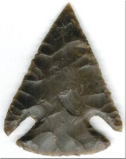
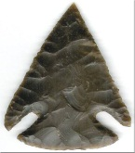

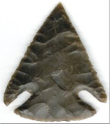
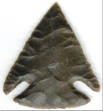
Menu
Lipan Apache
Karankawa
Caddo
Jumano
Test

Slide 4

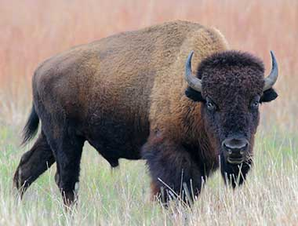
Lipan Apache
Life
Regions
Fact
Main Menu

Slide 5
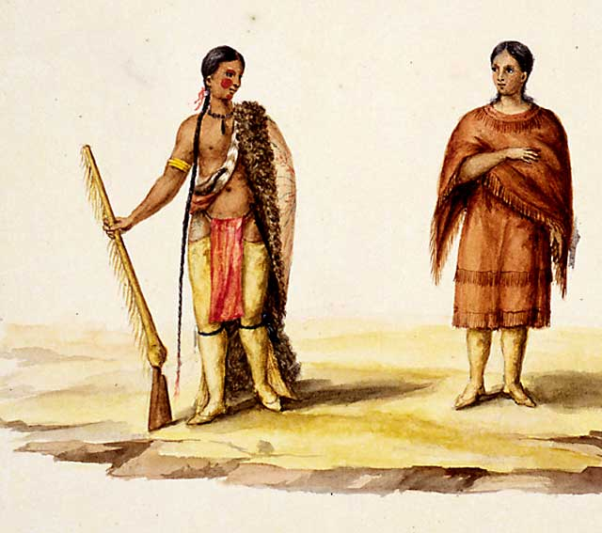
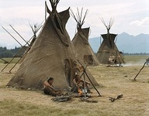
Life
Apache Women were in charge of the home. They cooked, cleaned, and built houses when the tribe moved.
Both Men and Women told lots of stories and made artwork, music, and traditional medicine.
Apache people lived in homes called wickiups
Let’s Learn More!

Slide 6
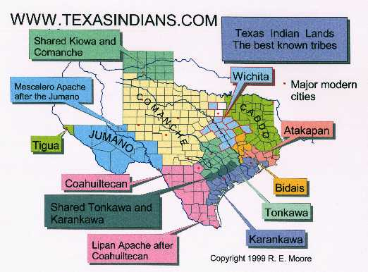
Regions
Apaches lived in the Southwest deserts, in Arizona, New mexico and Texas. One tribe also lived in Oklahoma and some people lived in northern Mexico, just across the Border.
Let’s Learn More!

Slide 7
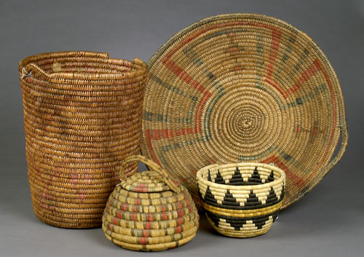
Fact
Apache artists are very Famous for their Fine Beadwork and Basketry!
Let’s Learn More!

Slide 8

Karankawa
Life
Regions
Fact
Main Menu

Slide 9
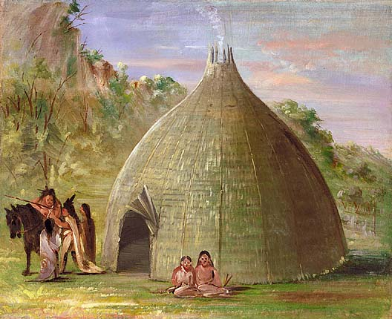
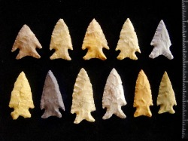
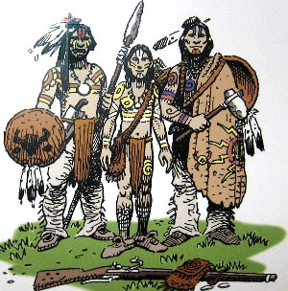
Life
The Karankawa would make their camps in the same place year after year.
Some of the Karankawa Warriors were over 6 feet tall! That was very big, most people were shorter back then!
Karankawa Indians are all gone now, they disappeared in the early 1800’s.
Let’s Learn More!

Slide 10
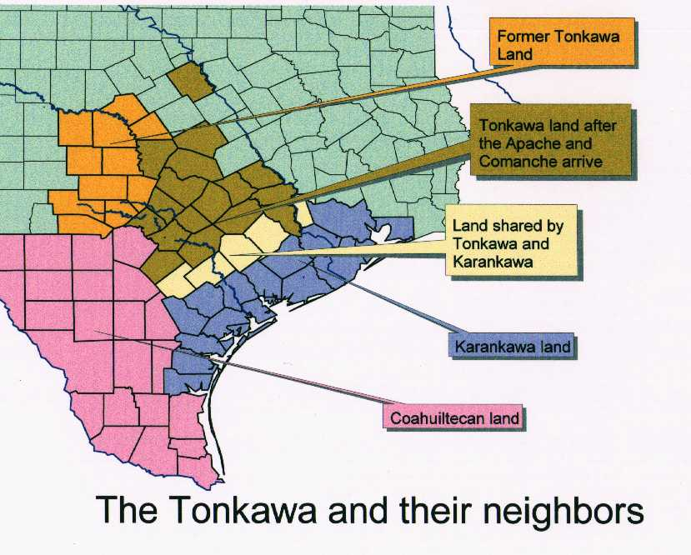
Region
Karankawa indians lived in Texas on the Coast of the Gulf of Mexico, their “territory” ranged from Galveston Island down to what we know as Corpus Christi.
Let’s Learn More!

Slide 11
Fact
Some people thought that the Karankawa indians were Cannibals, but they were not!
Let’s Learn More!

Slide 12
Caddo
Life
Regions
Fact
Main Menu

Slide 13
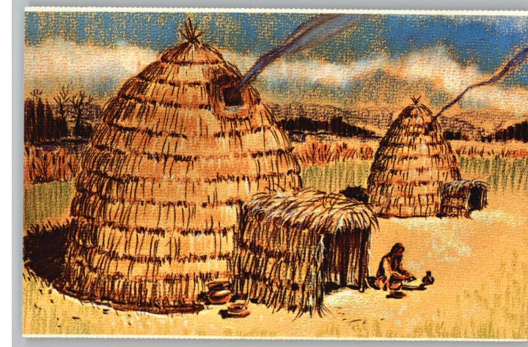
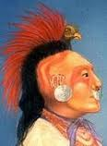
Life
Caddo men were hunters and sometimes warriors, while the women were farmers and took care of the families and housework.
Caddos lived in in grass huts not tepees.
Caddos didn’t wear large headdresses but the men usually wore their hair in mohawks.
Let’s Learn More!

Slide 14
Region
Caddos originally lived in Texas, Oklahoma, Louisiana and Arkansas. Now Caddo people live mostly in Oklahoma.
Let’s Learn More!

Slide 15
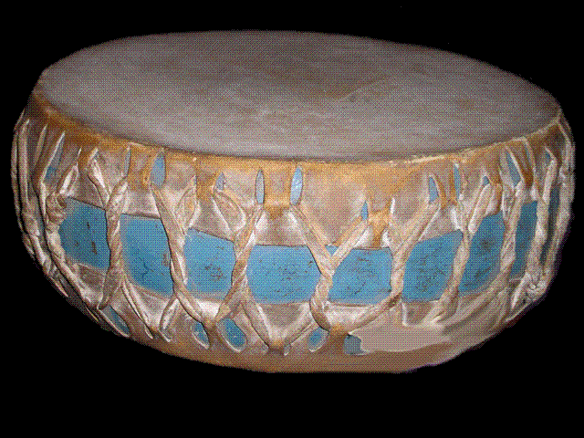
Fact
The most important instrument for the Caddos was the drum. Caddo men would play the huge drum while other danced and sang.
Let’s Learn More!
Click the drum to see what type of art and crafts the Caddo Indians are most famous for!

Slide 16
Jumano
Life
Regions
Fact
Main Menu

Slide 17
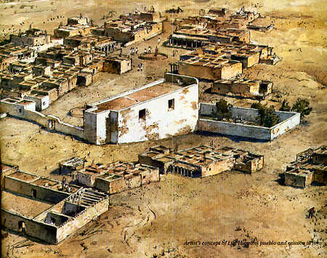
Life
Jumanos lived in Puebloan type villages in houses that were sometimes two or three stories tall.
Jumanos were buffalo hunters, and traders.
Men cut their hair very short but left on long strand which they decorated with feathers and paint.
Let’s Learn More!

Slide 18
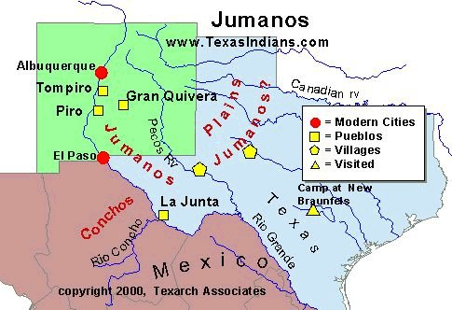
Region
The Jumano Indians lived over a range of Northern Mexico, New Mexico and Texas. The biggest territory base was between the lower Pecos River and the Colorado river.
Let’s Learn More!

Slide 19
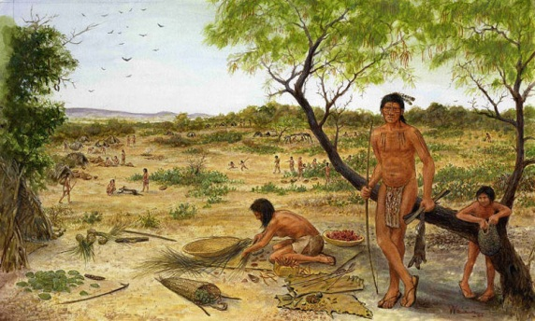
Fact
Jumanos were sometimes called the “naked” tribe because they didn’t always cover up their private parts.
Let’s Learn More!

Slide 20
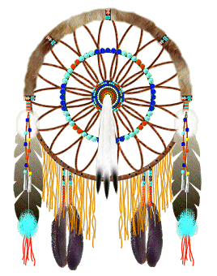
Test Question #1
What tribe is famous for their fine beadwork and Basketry?
Lipan Apache
Jumano
Caddo
*Click the dream catcher that is next to the right answer

Slide 21
Test Question #2
Which tribe lived in two or three story houses?
Apache
Jumano
Caddo

Slide 22
Test Question #3
Which Indians were thought to be cannibals but actually weren’t?
Apache
Karankawa
Caddo
Jumano

Slide 23
Test Question #4
Which Indians are no longer around?
Jumano
Caddo
Apache
Karankawa

Slide 24
Test Question #5
Which tribe was known as the “Naked” tribe?
Caddo
Apache
Jumano
Karankawa

Slide 25
Test Question #6
Where do most Caddo people live today?
Arizona
Colorado
Oklahoma
New Mexico

Slide 26
Test Question #7
What were the Apache’s homes called?
Tepees
Pueblos
Wickiups
Apartments

Slide 27
Test Question #8
What type of arts and crafts were the Caddos most famous for?
Headdresses
Paintings
Pottery

Slide 28
Congratulations!

Slide 29
Citations
www.googleimages.com
, Buffalo, Arrowhead, American Indian Dreamcatcher, apache basketry, big karankawa warriors, caddo mohawk
Clip Art
Drum, Native American (sounds)
www.bingimages.com
Lipan Apache Indians, Jumano Indians, Caddo Indians, Karankawa Indians
http://www.bigorrin.org/caddo_kids.htm
www.texasindians.com/apach.htm
http://www.bigorrin.org/apache_kids.htm
http://www.texasindians.com/jumano.htm
http://www.tshaonline.org/handbook/online/articles/bmj07

